Slide 1

Department of Mechanical Engineering Indian Institute of Technology Tirupati
B. Tech Final Year Project Presentation
DESIGN AND FABRICATION OF EXPERIMENT FOR DYNAMIC ANALYSIS OF MECHANISMS
Aakash (ME16B001)
A. Akhil (ME16B003)
Supervised by
Dr. Sriram Sundar, Assistant Prof of ME
Date: 11-Mar-2020

Slide 2

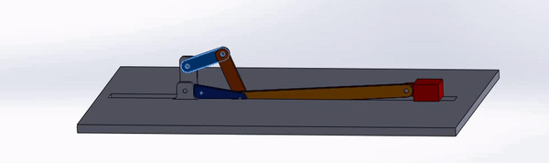
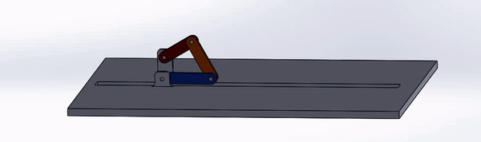
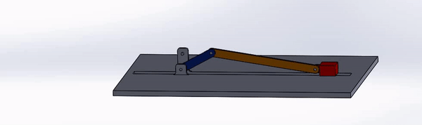
Objectives and Motivation
Dept. of Mechanical Engineering
B. Tech Final Year Project Presentation
Introduction - Design and fabrication of experimental setup for static, kinematic and dynamic analysis of mechanisms with retrofitted parts.
Motivation - The experiment will supplement and reinforce the theoretical understanding of the undergraduate students taking the ME2206 (KDM) course.
Six bar mechanism
Four bar mechanism
Slider crank mechanism
Notes:
by providing them the opportunity to match the analytical results with the actual experimental results.
to facilitate multiple experiments in the same setup.

Slide 3

Experiment plan
Dept. of Mechanical Engineering
B. Tech Final Year Project Presentation
Aim:
1. To find the slider velocity and acceleration for six bar mechanism and slider crank mechanism
2. To find angular velocity and angular acceleration of all links in double crank mechanism.
Methodology and Results:
This experimental setup will store the data of all parameters for each angular position.
Students can select the angular position in the experimental setup to get the stored data display.
Students need to solve theoretically for any particular angular position of mechanism.
Students can compare theoretical results with practical results.

Slide 4
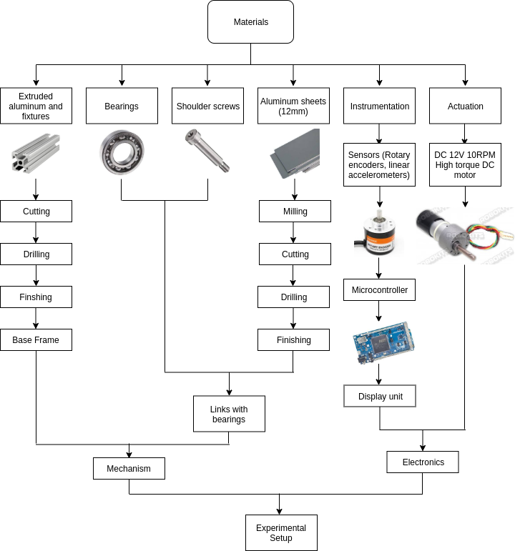
Manufacturing plan
Dept. of Mechanical Engineering
B. Tech Final Year Project Presentation

Slide 5
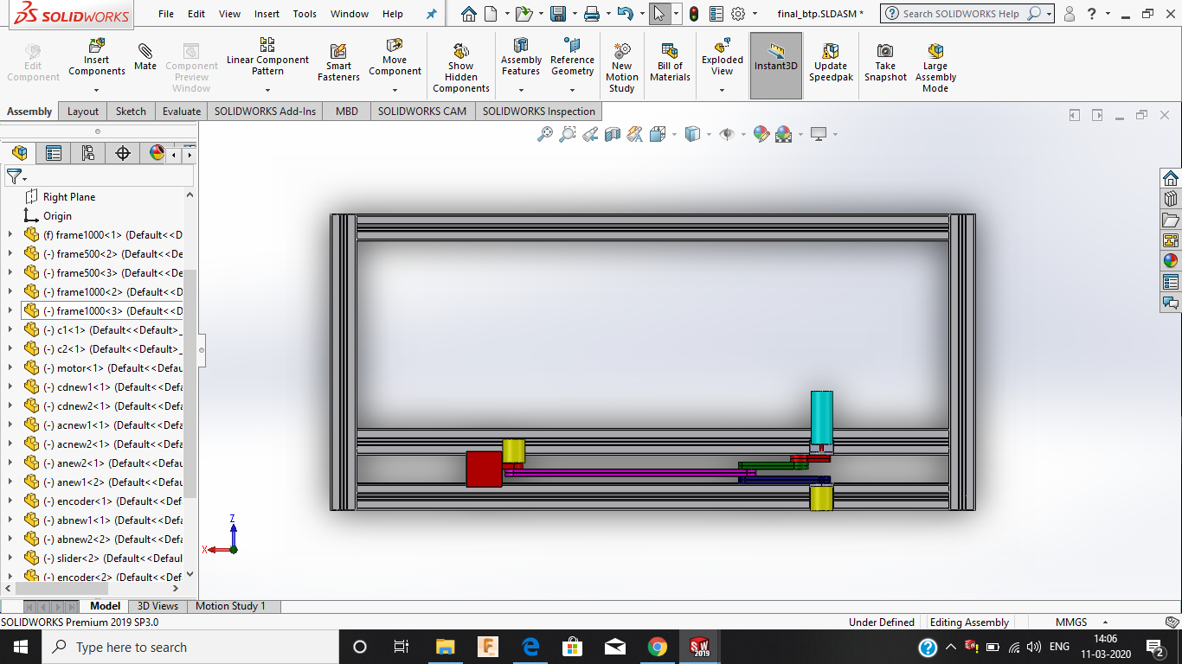
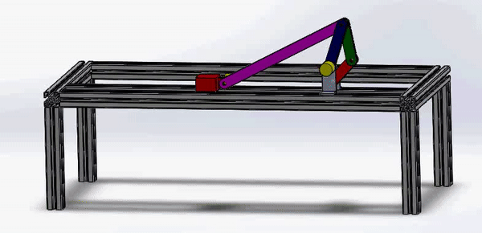
Updated CAD Design
Dept. of Mechanical Engineering
B. Tech Final Year Project Presentation
Extruded aluminum frame
Rotary actuator
Rotary encoder
CAD: Motion Study
CAD: Top view
Notes:
Full model design and assembly considering all the manufacturing process.
The design shall ease the process of manufacturing and assembly of the final setup.

Slide 6
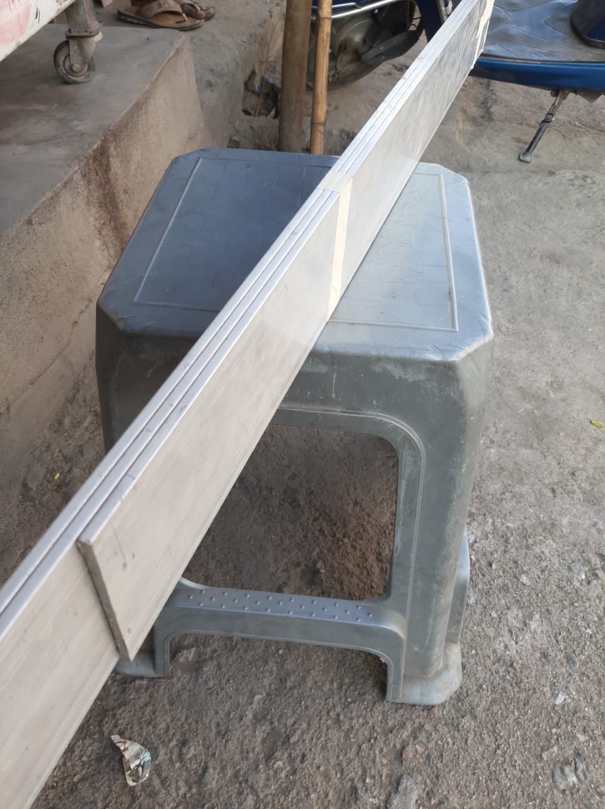
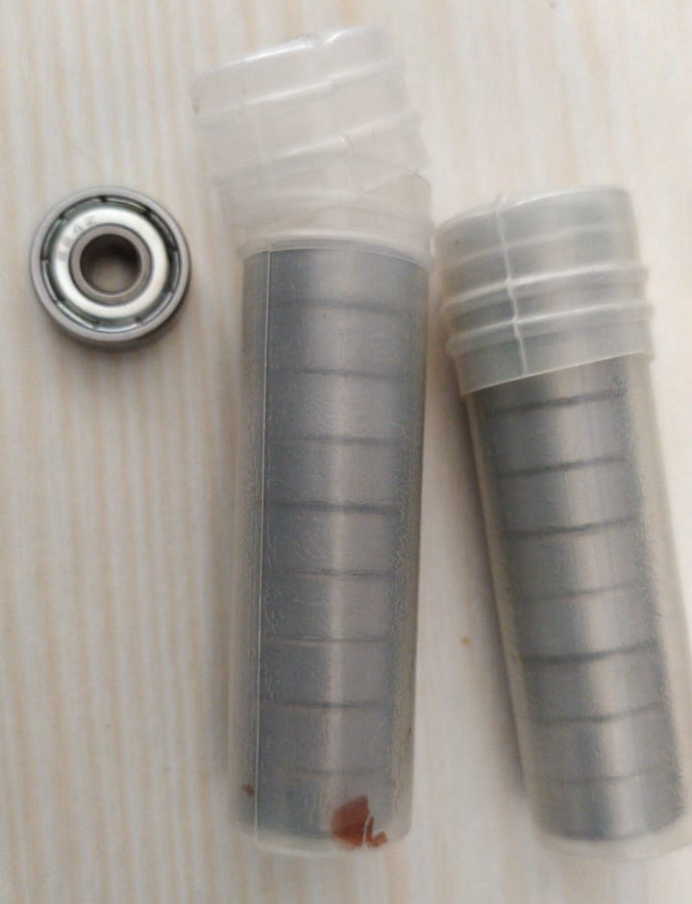
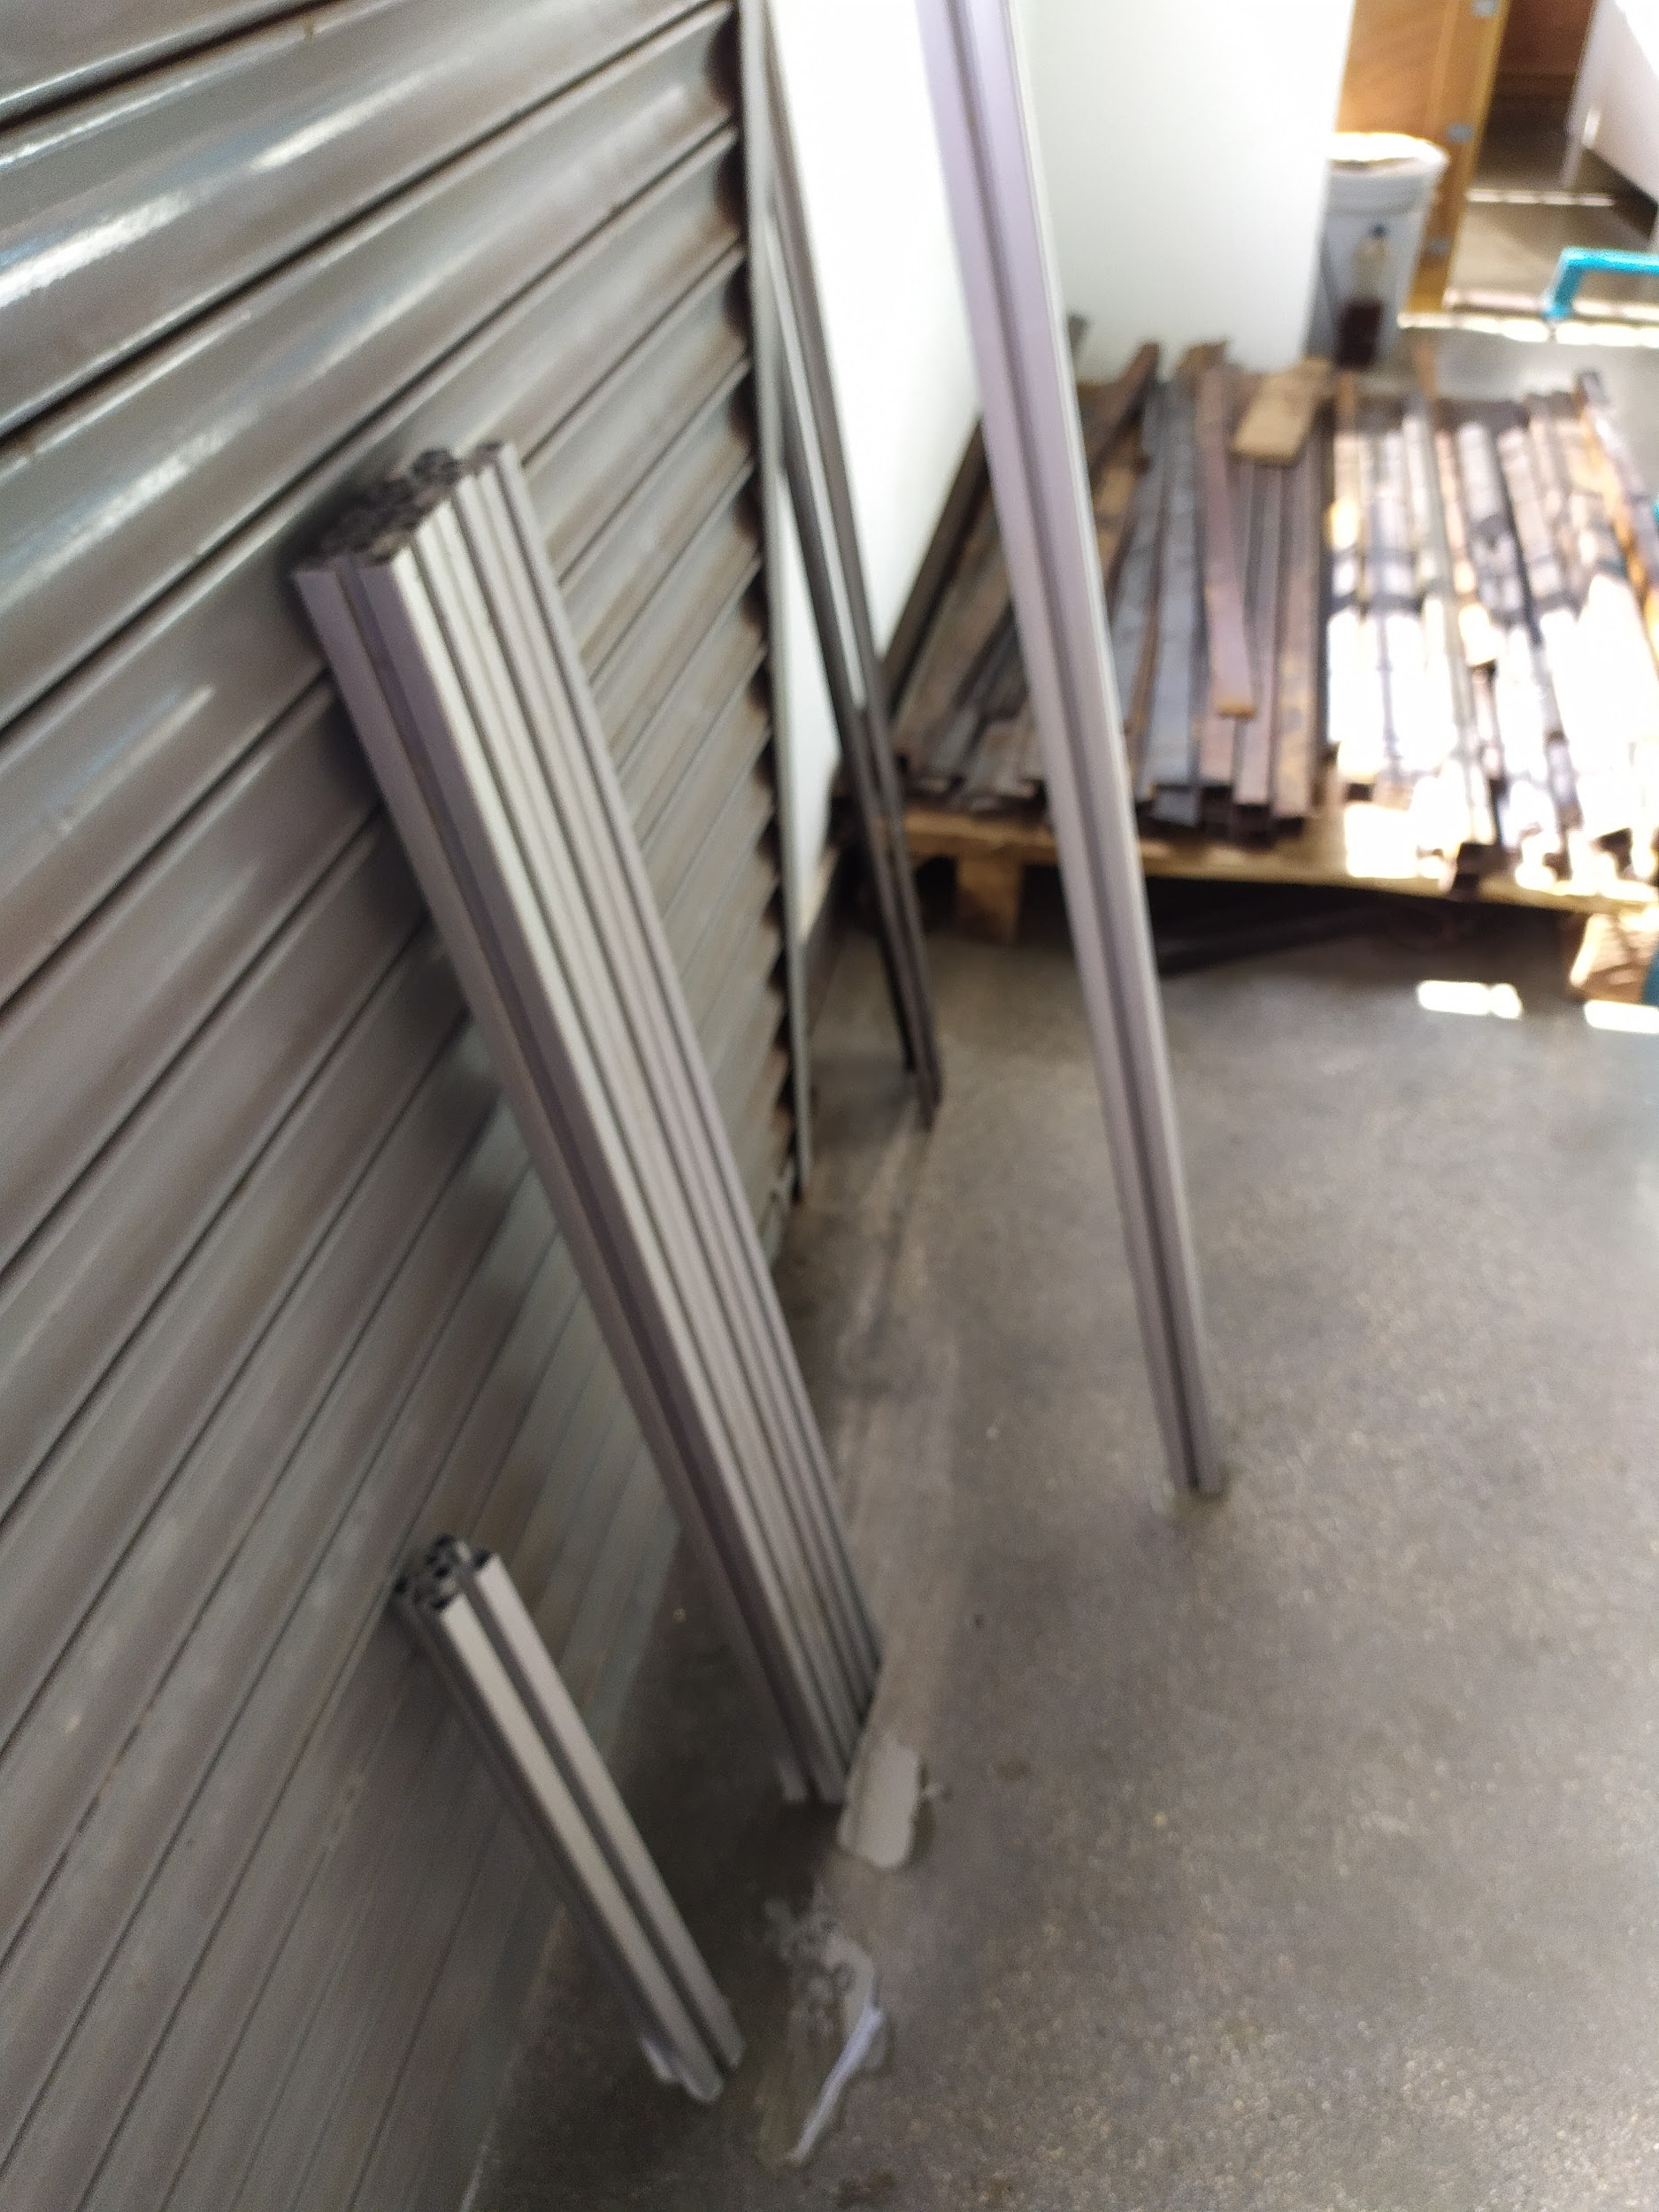
Raw materials
Dept. of Mechanical Engineering
B. Tech Final Year Project Presentation
Aluminium flat
Bearings
Extruded aluminium frame

Slide 7
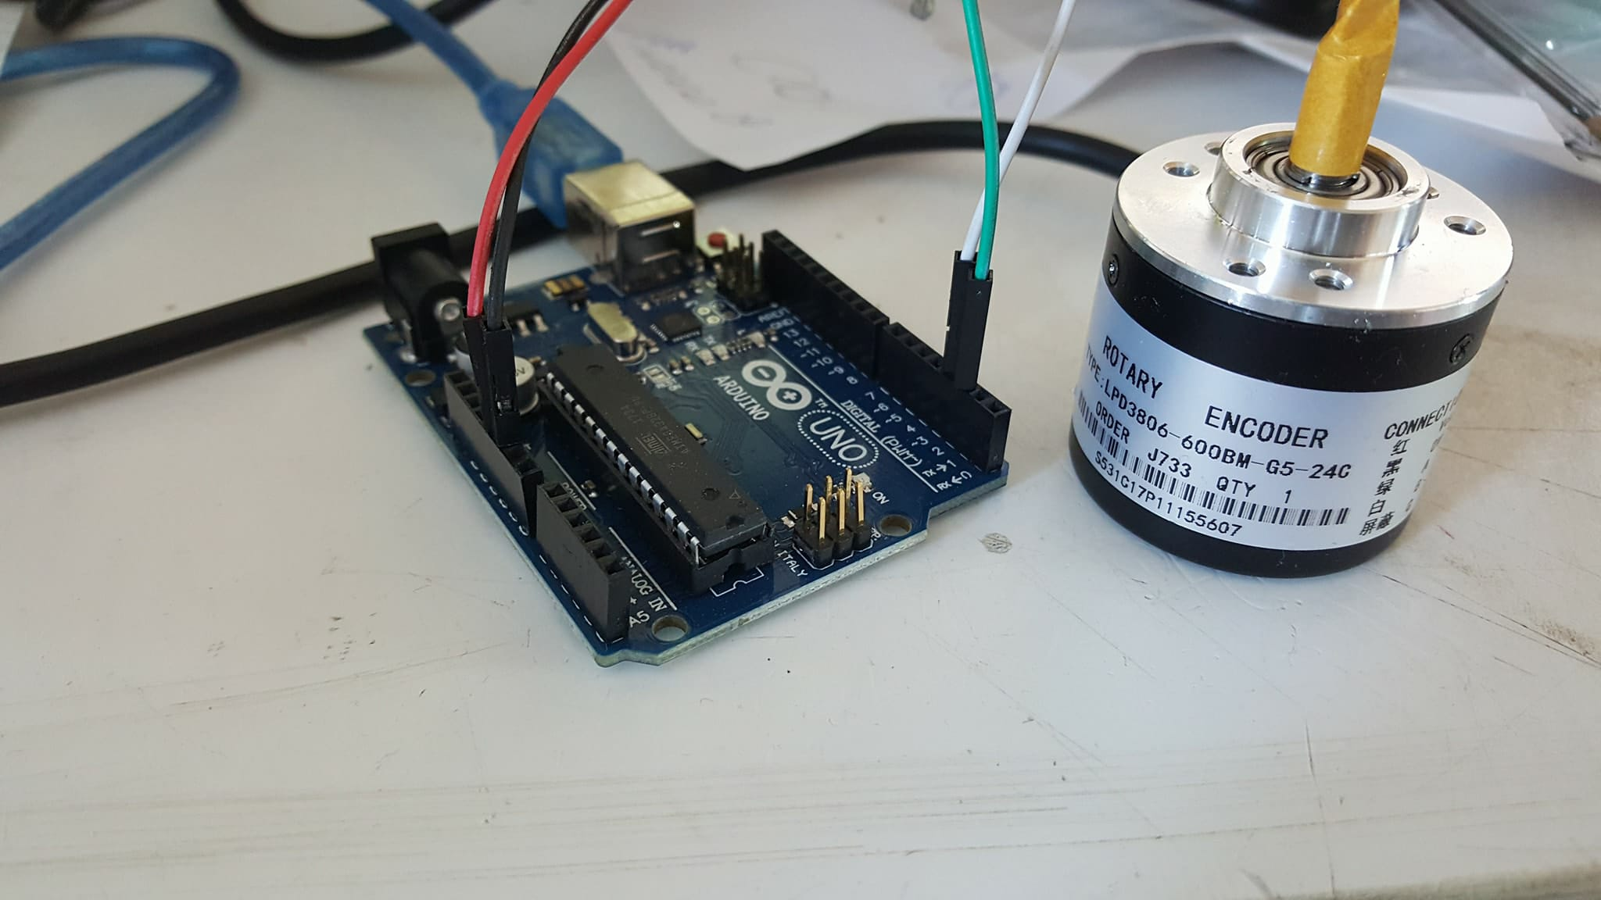
Testing of Rotary Encoder
Dept. of Mechanical Engineering
B. Tech Final Year Project Presentation
600 PPR Rotary encoder was selected and purchased
In-house Arduino program was used to test the encoder for measuring rotation angles.

Slide 8
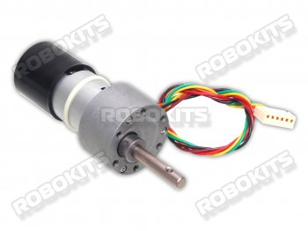
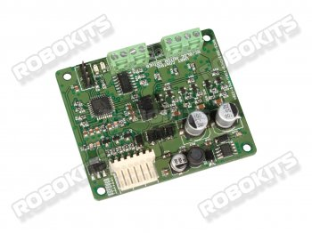
Actuator selection
Dept. of Mechanical Engineering
B. Tech Final Year Project Presentation
DC 12V 10 rpm high torque quad encoder motor
DC servo driver

Slide 9
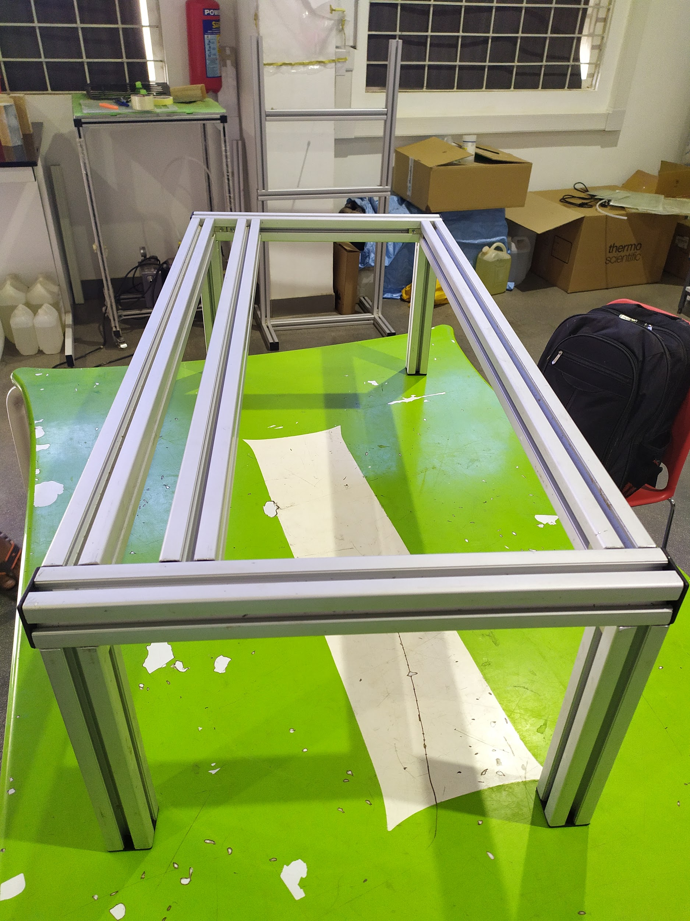
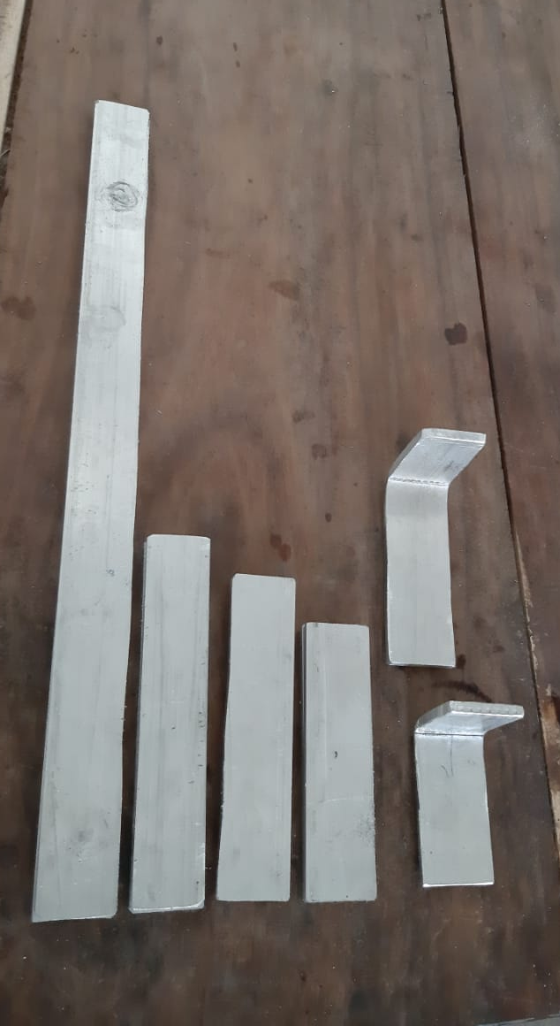
Fabrication
Dept. of Mechanical Engineering
B. Tech Final Year Project Presentation
Extruded aluminium frame
Assembled base
Links and L-joint
Notes:
Extruded aluminum was used to create the base frame
The parts were cut to the design length using the band saw

Slide 10
Conclusions
Dept. of Mechanical Engineering
B. Tech Final Year Project Presentation
Full fledged CAD model of the mechanism was created considering all the manufacturing challenges (Design for manufacturing).
All the required raw material were procured
Rotary encoders were tested for angle measurement using Arduino.
The base frame has been assembled while manufacturing and assembly of the links is in process.

Slide 11
Future Work
Dept. of Mechanical Engineering
B. Tech Final Year Project Presentation
Fabrication
(31st March)
Testing
(10th April)
Documentation
Fabrication and assembly of links.
Integration of encoders and other electronics
Experimentation, testing and validation.
Design changes if required
Creation of experiment manual and documentation.

Slide 12
References
Dept. of Mechanical Engineering
B. Tech Final Year Project Presentation
A. Ghosh and A. K. Mallik, Theory of mechanisms and machines. Affiliated East-West Press Private Limited, 2002.
R. L. Norton, Kinematics and dynamics of machinery. McGraw-Hill Higher Education, 2011.
J. J. Uicker, G. R. Pennock, J. E. Shigley, et al., Theory of machines and mechanisms, volume 1. Oxford University Press New York, NY, 2011.

Slide 13
END

Slide 14
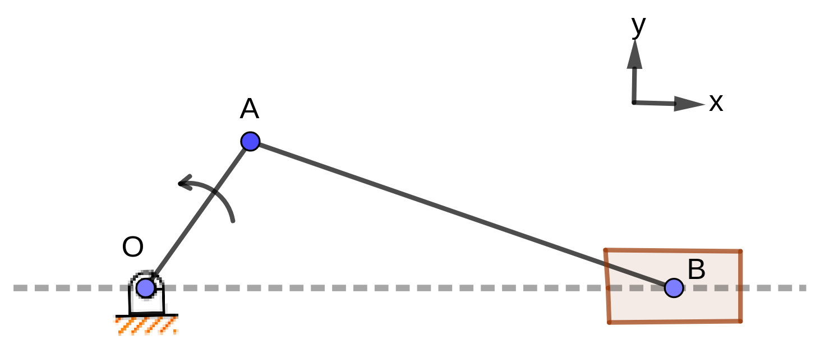
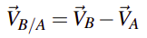
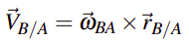
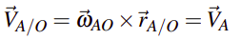
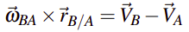
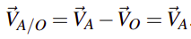
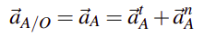
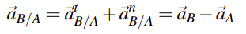
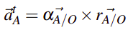
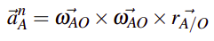
Mathematical Formulation
Dept. of Mechanical Engineering
B. Tech Final Year Project Presentation
Kinematics analysis
Finding angular velocity (AB) and slider velocity
Slider crank mechanism
Finding angular acceleration (AB) and slider acceleration
Note: there may be missing steps and common notations for the sake of brevity. Refer to report for completeness.

Slide 15
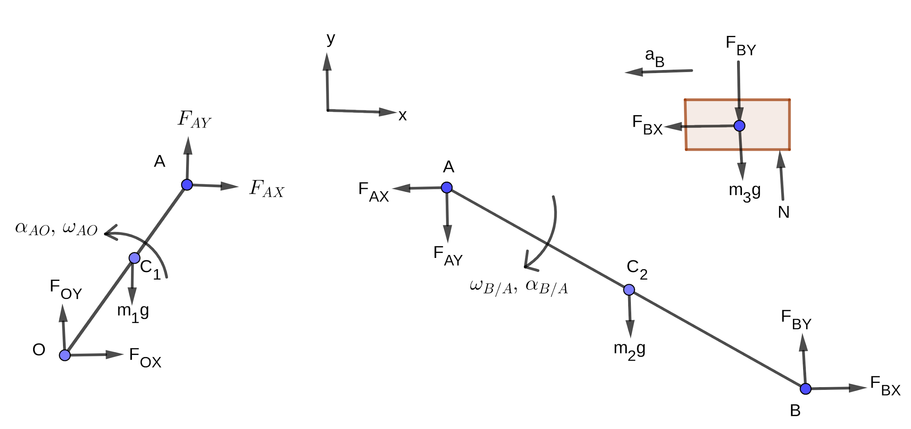
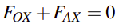
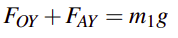
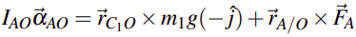
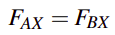
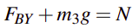
Mathematical Formulation
Dept. of Mechanical Engineering
B. Tech Final Year Project Presentation
Dynamic analysis
Force and torque balance for link OA
Slider crank mechanism
Force and torque balance for link AB
Force balance for slider
Note: there may be missing steps and common notations for the sake of brevity. Refer to report for completeness.

Slide 16
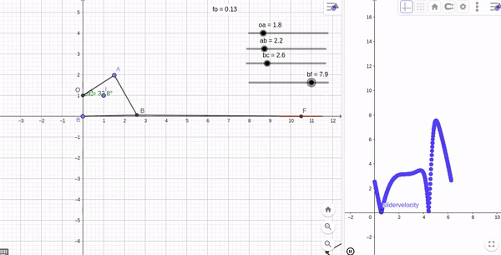
Kinematic Analysis
Dept. of Mechanical Engineering
B. Tech Final Year Project Presentation
By using Geogebra, we obtained preliminary link lengths and slider velocity profile.
Analysed the velocity profile by changing link lengths.

Slide 17
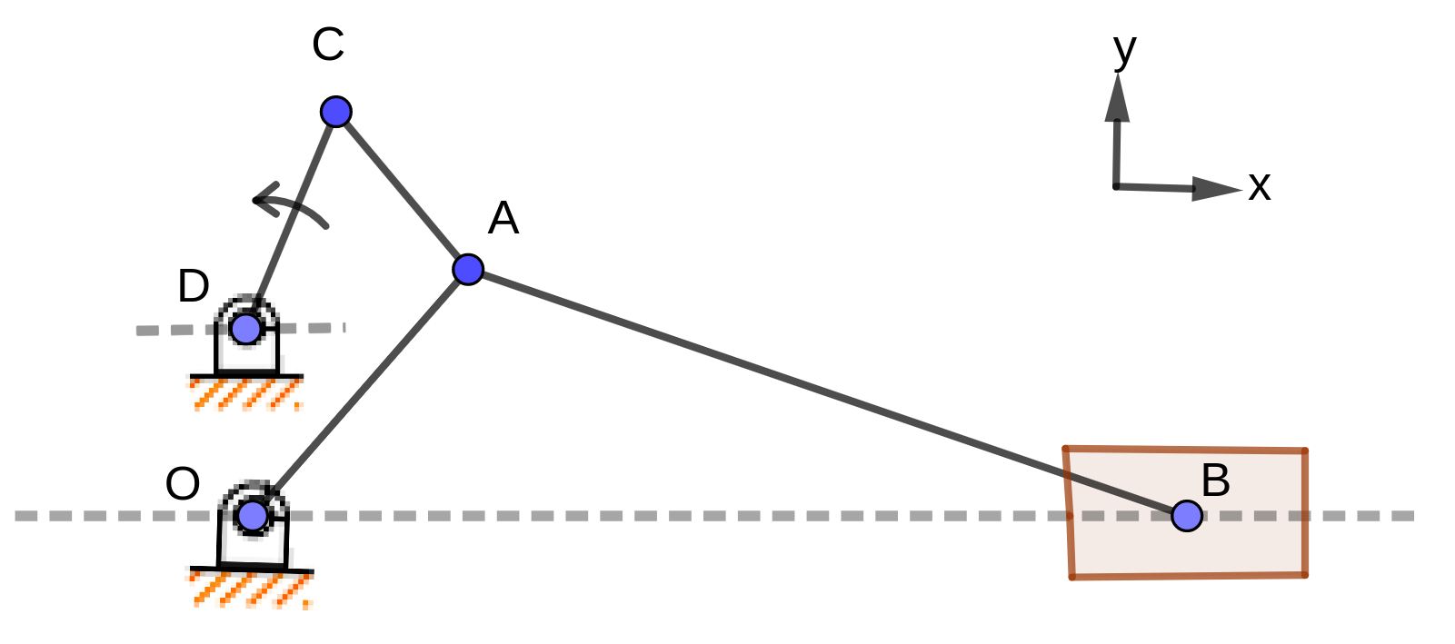
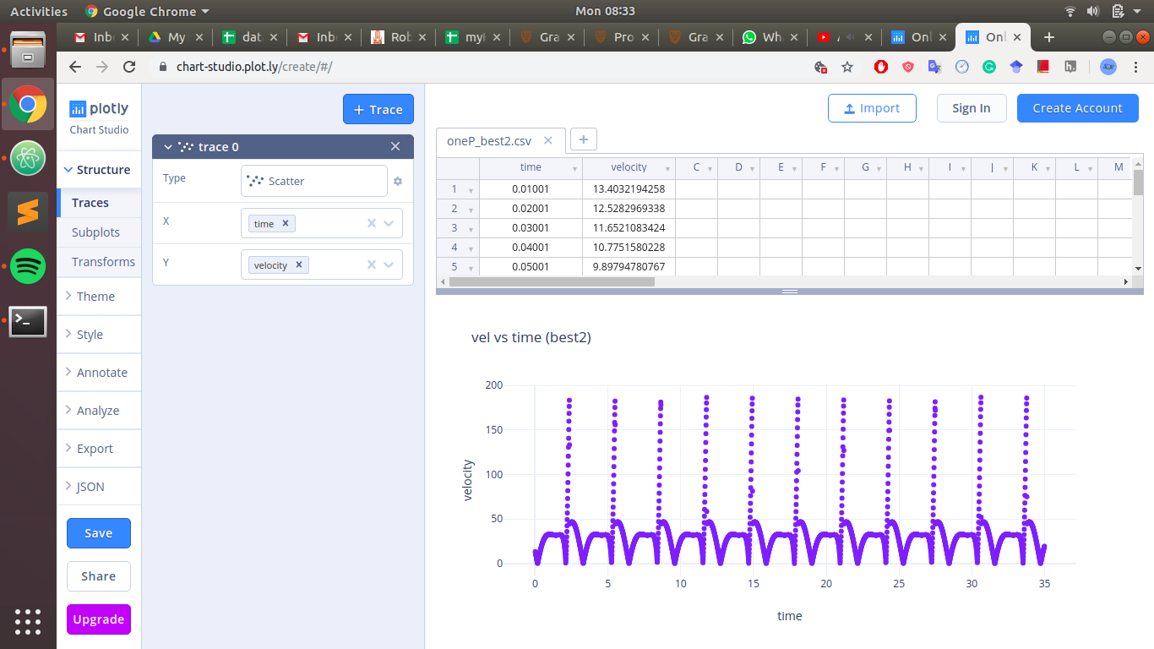
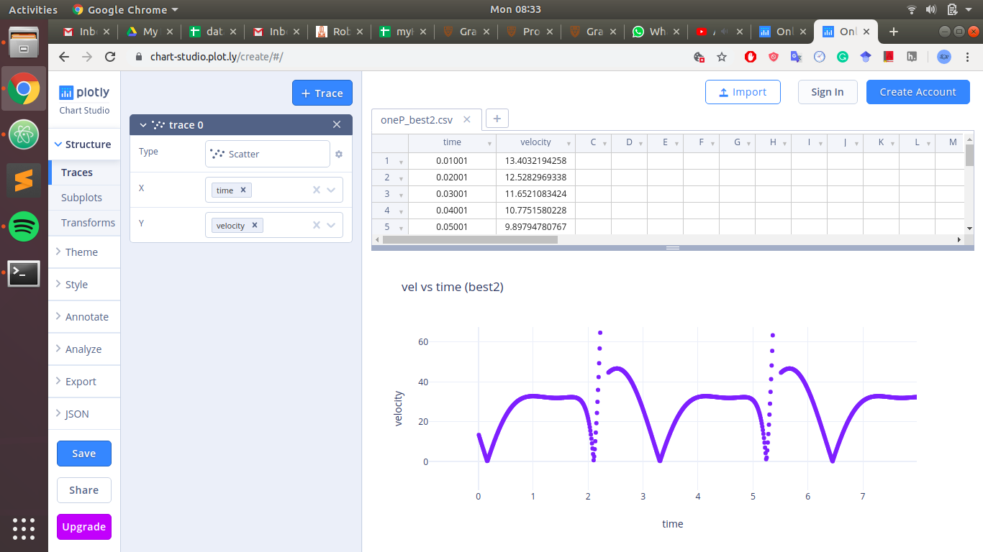
Design for constant velocity
Dept. of Mechanical Engineering
B. Tech Final Year Project Presentation
Iteration over preliminary length ratios obtained from GeoGebra
Obtained length ratios for minimal velocity variation
OA | AB | CD | AC
26 | 79 | 18 | 22
Velocity (unit/s) vs time

Slide 18
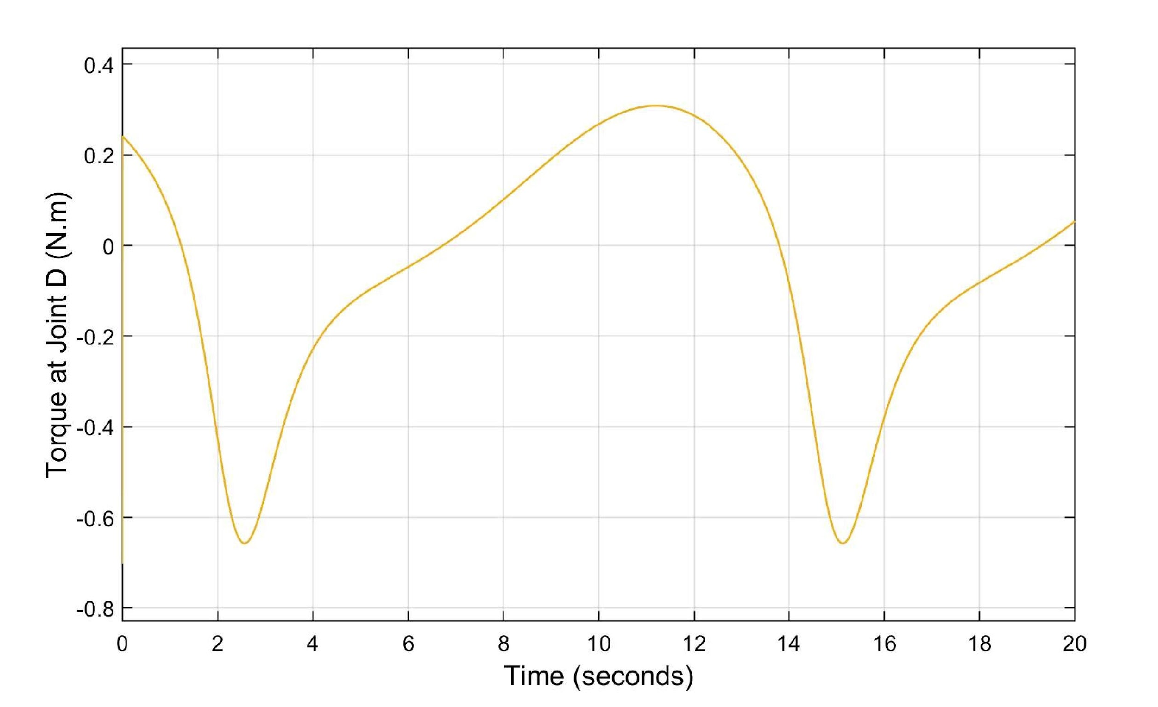
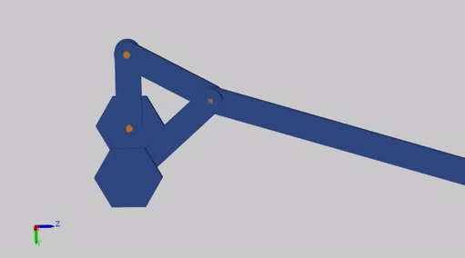
Dynamic Analysis
Dept. of Mechanical Engineering
B. Tech Final Year Project Presentation
Dynamic and kinematic analysis helps in designing mechanism which is suitable for taking measurements.

Slide 19
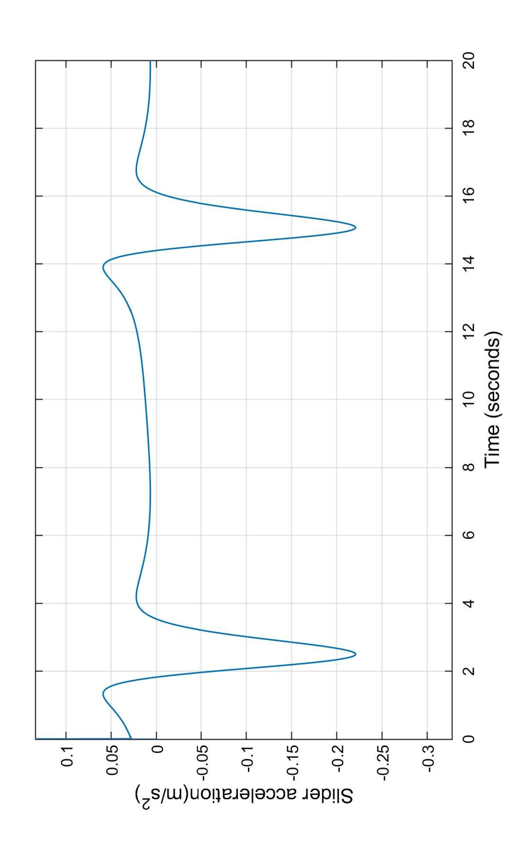
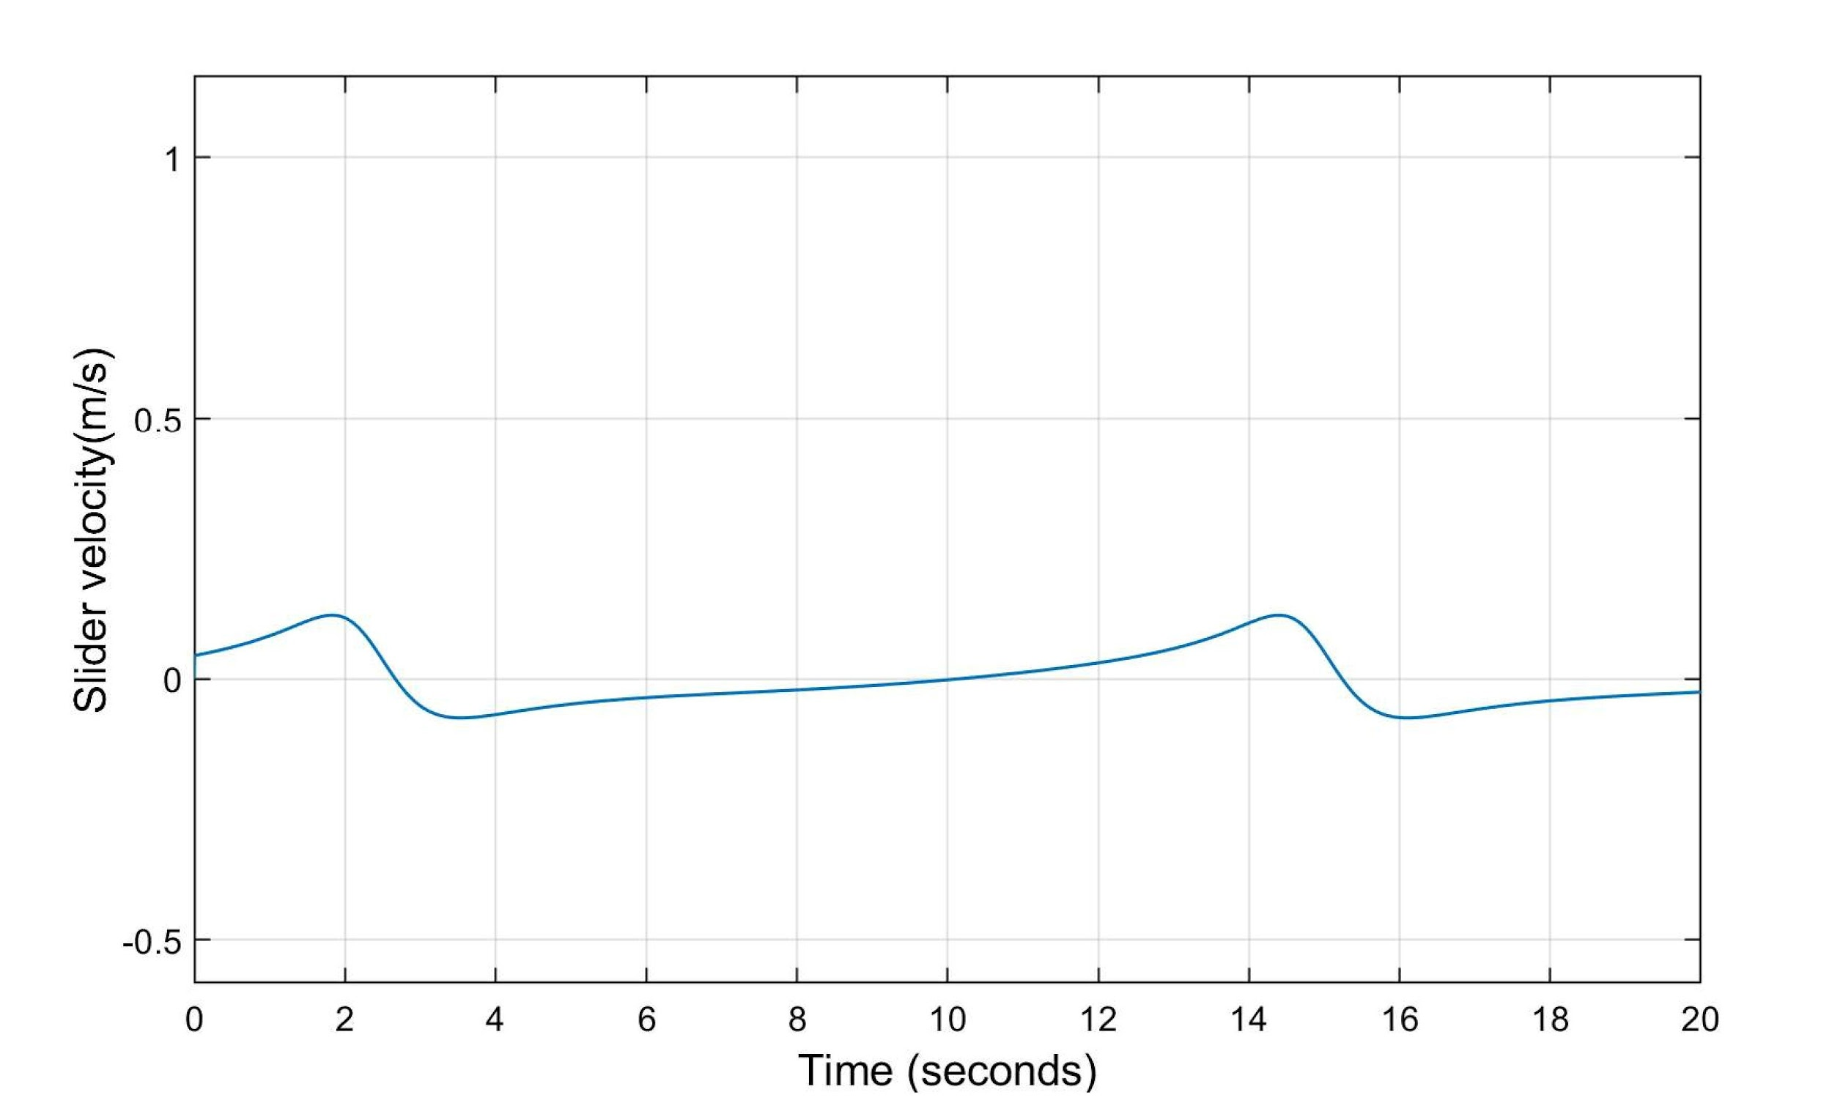
Results
Dept. of Mechanical Engineering
B. Tech Final Year Project Presentation

Slide 20
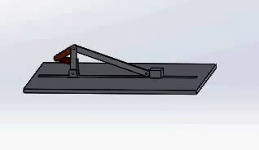
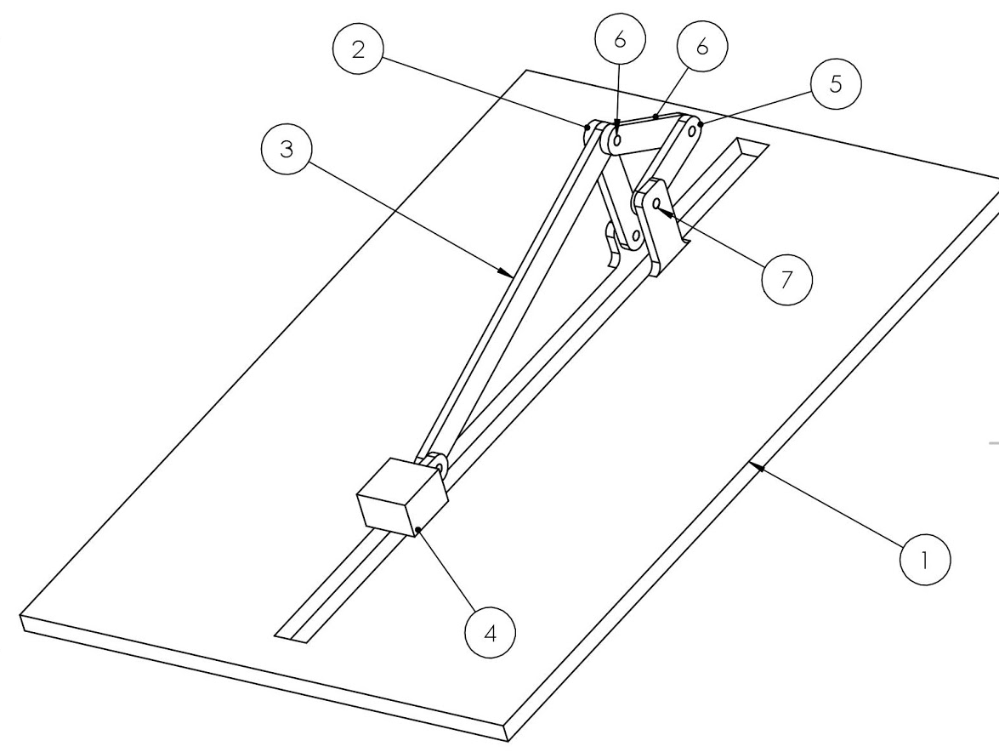
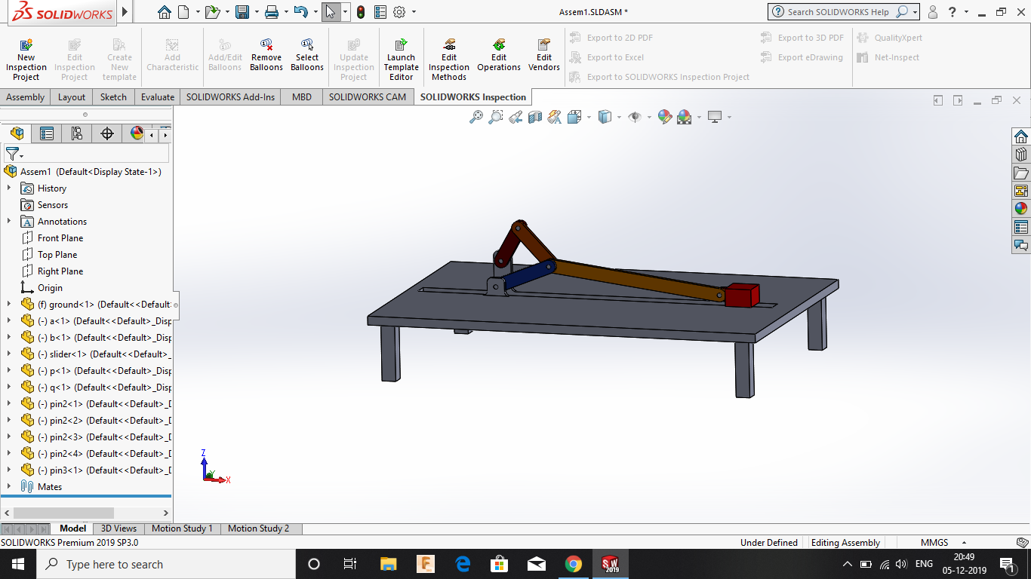
3D Model
Dept. of Mechanical Engineering
B. Tech Final Year Project Presentation
Part number | Part Name
1 | Ground
2 | Link OA
3 | Link AB
4 | Slider
5 | Link CD
6 | Link AC
The above models were rendered using SolidWorks

Slide 21

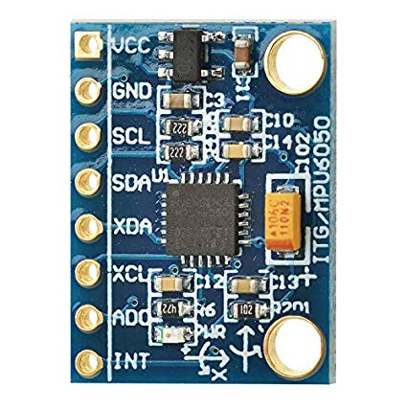
Sensor selection
Dept. of Mechanical Engineering
B. Tech Final Year Project Presentation
Based on the results obtained from kinematic and dynamic analysis using MathWorks Simscape, we selected the required sensors.
2-Phase Incremental Optical Rotary Encoder to detect angular velocity and angular acceleration of links
3-Axis Accelerometer is to detect linear acceleration and linear velocity of slider.
Source: robu.in
Source: amazon.in

Slide 22
Cost Analysis
Dept. of Mechanical Engineering
B. Tech Final Year Project Presentation
No | Name | Unit cost in INR | Quantity | Cost in INR
1 | Bearing | 50 | 20 | 1000
2 | Shoulder screw | 20 | 6 | 120
3 | Aluminum (for links and slider) | 200 per kg | 15kg | 3000
4 | Extruded Aluminum | 400 per m | 5 | 2000
5 | Actuator | - | - | -
6 | Rotary Encoder | 2000 | 3 | 6000
7 | Linear Accelerometer (8kHz) | 200 | 1 | 200
8 | Display | 1000 | 1 | 1000
9 | Other Electronics and miscellaneous |  |  | 5000
10 | Slotted weights, pulley | 2000 | 1 | 2000
 | Grand Total |  |  | 20,320/-
Note: tentative, minor changes may occur.

Slide 23
Conclusions
Dept. of Mechanical Engineering
B. Tech Final Year Project Presentation
The complete analysis of the mechanism(s) was performed using applicable method and software.
3D CAD model of the mechanism was created to facilitate better visualisation.
Various design considerations were addressed and manufacturing workflow and plan were accomplished as a prerequisite to manufacturing.
BoM was prepared and materials acquisition from the vendor is in process.

Slide 24
Future Work
Dept. of Mechanical Engineering
B. Tech Final Year Project Presentation
Actuator selection
Final Design
Fabrication
Need to find the best actuator with its control system.
Final prototype model consisting of links, bearings, motors, sensors, etc.
Fabrication and assembling of links.
Experimentation, testing and validation.

Slide 25
References
Dept. of Mechanical Engineering
B. Tech Final Year Project Presentation
MATLAB version 9.3.0.713579 (R2017b). The Mathworks, Inc., Natick, Massachusetts, 2017.
A. Ghosh and A. K. Mallik, Theory of mechanisms and machines. Affiliated East-West Press Private Limited, 2002.
M. Hohenwarter, M. Borcherds, G. Ancsin, B. Bencze, M. Blossier, A. Delobelle, C. Denizet, J. Éliás, A. Fekete, L. Gál, Z. Konecný ˇ , Z. Kovács, S. Lizelfelner, B. Parisse, and G. Sturr (2013). GeoGebra 4.4. http://www.geogebra.org.
R. L. Norton, Kinematics and dynamics of machinery. McGraw-Hill Higher Education, 2011.
Python Core Team (2018). Python: A dynamic, open source programming language. Python Software Foundation. URL https://www.python.org/.
J. J. Uicker, G. R. Pennock, J. E. Shigley, et al., Theory of machines and mechanisms, volume 1. Oxford University Press New York, NY, 2011.

Slide 26
Acknowledgements
Dept. of Mechanical Engineering
B. Tech Final Year Project Presentation
Thanks to all those who helped us during the course of our B.Tech. project at IIT Tirupati. We are thankful to and fortunate enough to get constant encouragement, support and guidance from Dr. Sriram Sundar of Mechanical Engineering Department which helped us in successfully completing first phase of our project work. We would also like to extend our sincere esteems to all staff in laboratory for their timely support.
To our families, thank you for encouraging us in all of our pursuits and inspiring us to follow our dreams. We are especially grateful to our parents, who supported us emotionally and financially.

Slide 27
END

Slide 28
Supplementary material

Slide 29
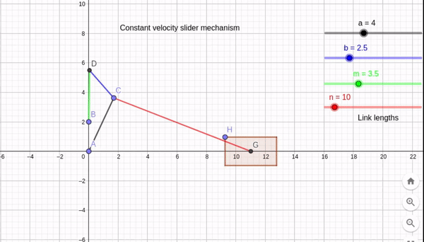
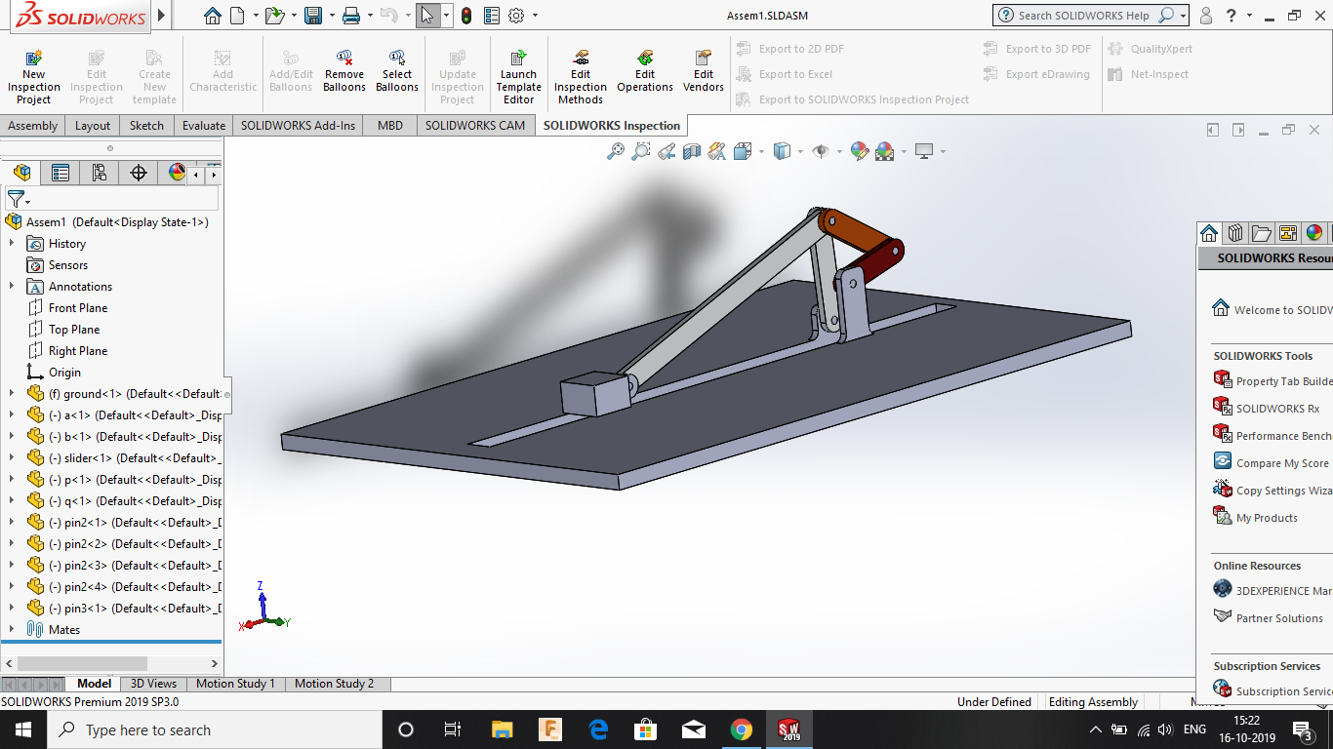
Updates
Dept. of Mechanical Engineering
B. Tech Final Year Project Presentation
GeoGebra
Python
Simscape
Sensors selection
Velocity (unit/s) vs time
Notes:
3D Modelling of the system with realistic dimensions to assist in fabrication and final designing.
Dynamic analysis of mechanism carried out in simscape(MATLAB).
Iterations were carried out in order to come up with a constant velocity mechanism having least variation
Preliminary kinematic analysis of mechanism.

Slide 30
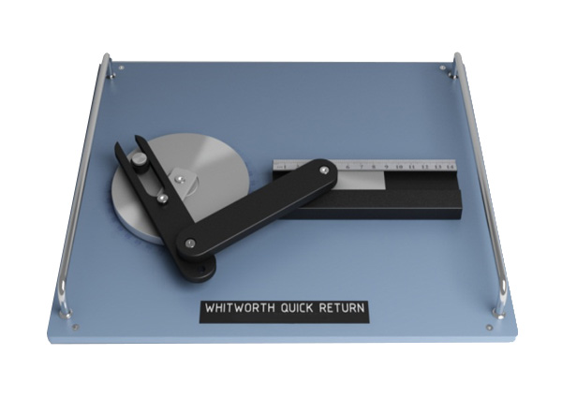
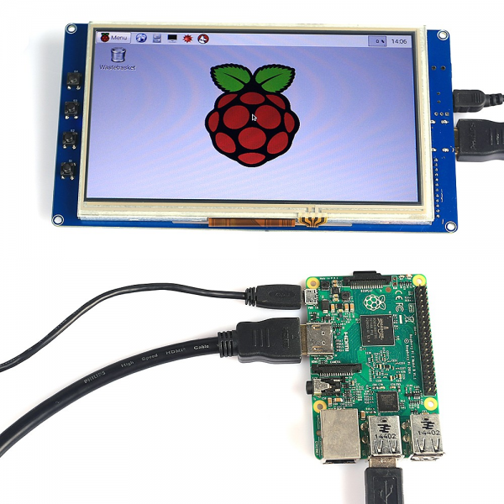
Introduction and Objectives
Dept. of Mechanical Engineering
B. Tech Final Year Project Presentation
To design and fabricate an experimental setup for static, kinematic and dynamic analysis of mechanism.
The setup will have retrofitted parts in order to let the student carry out multiple experiments in the same setup.
The experiment will supplement and reinforce the theoretical understanding of the undergraduate students taking the ME2206(KDM) by providing them the opportunity to match the analytical results with the actual experimental results.
source: ardubotics.com
source: sun labtech
Notes:
The field and/or area in which you will be working
(b) The aim and objectives of your work.
(c) The importance of your work and its applications

Slide 31
Plan
Dept. of Mechanical Engineering
B. Tech Final Year Project Presentation
Theoretical analysis
3D Modelling
Documentation
GeoGebra Modelling and sensor identification
Prototyping, Fabrication and Testing
Estimated budget : INR 25,000.00 - 30,000.00
Probable sensors for instrumentation: Rotary encoders, Ultrasonic range sensors, linear accelerometers, strain gauges

Slide 32
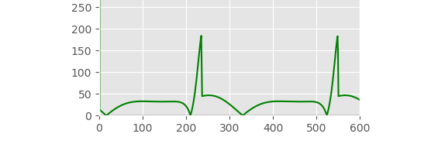
Literature Review
Dept. of Mechanical Engineering
B. Tech Final Year Project Presentation
Kinematics and Dynamics of Machinery, Robert L. Norton
Theory of Mechanisms and Machines, Ghosh and Mallik
Theory of Machines and Mechanisms, Uicker, Pennock and Shigley

Slide 33
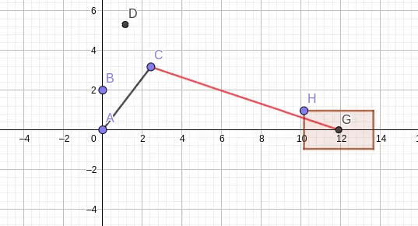
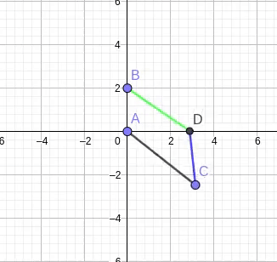
Mechanism
Dept. of Mechanical Engineering
B. Tech Final Year Project Presentation

